Slide 1


Human-Centered Artificial Intelligence + Modern AI
SIT112 | Intro to Data Science & AI
Lecture Week 11
School of Information Technology, Deakin University
Notes:
This lecture examines Human-Centred AI and modern AI systems. The central question is not only whether AI works, but whether it supports people, respects human values and avoids harm.

Slide 2
Objectives
👥 Explain Human-Centred AI
⚠️ Recognise ethical and social harm
⚖️ Describe responsible AI principles
🔄 Define an AI agent
🤖 Distinguish an AI model from an AI agent
🛡️ Design a responsible AI agent

Slide 3
Human Values
Notes:
This visual shows that humans value many things, including privacy, fairness, autonomy, security, trust and wellbeing. Technology can support some values while unintentionally damaging others.
Human values are the principles people consider important, such as fairness, privacy, freedom, trust, safety, dignity, wellbeing and belonging.
Different stakeholders may prioritise different values.
For example, a company may prioritise efficiency, while users prioritise privacy.
Human-Centred AI attempts to identify and balance these values during design.

Slide 4

  What could go wrong?
Notes:
AI and software can fail technically, but they can also create social, emotional, financial and ethical harm.
We therefore need to anticipate consequences before deploying a system.
Use this slide to introduce the risks of technology. A system can operate exactly as programmed and still produce an unethical, socially harmful or insensitive result.
Can software be technically correct but ethically wrong?
The following slides provide examples.

Slide 5

Hurricane Irma
Price Gouging
5 hours flight from Miami to Phoenix
Prices skyrocketed from $547 to over $3,258 USD
New York Times: “there are no ethics valves built into the system that prevent an airline from overcharging”
Notes:
During the hurricane, automated pricing raised a flight price from approximately USD 547 to more than USD 3,258.
The algorithm may have responded correctly to demand, but the result was ethically unacceptable during an emergency.
it exploited people trying to escape an emergency.

Slide 6
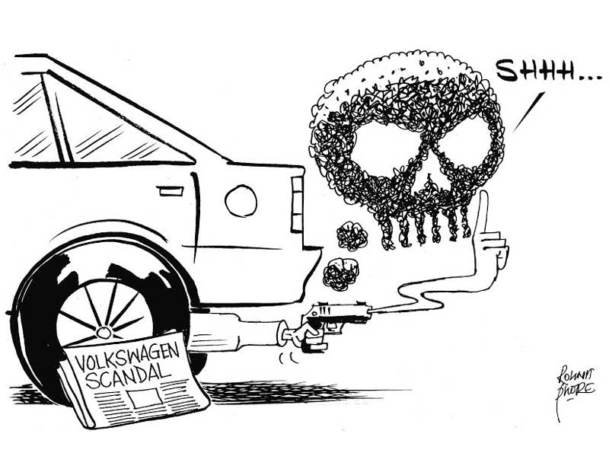
Volkswagen Fuel Emission Fiasco - 2015
A deceptively designed software suppressed the fuel emission control system on the road while keeping it engaged in the lab.
Breaching the company’s value “Responsible Thinking”
25% drop in sales in a year.
Resignation of the CEO
Notes:
Volkswagen deliberately programmed software to behave differently during laboratory tests and normal driving.
This shows that software reflects the goals and values of its designers—and can be intentionally designed to deceive.
Consequences included reputational damage, declining sales, financial penalties and executive resignations.

Slide 7
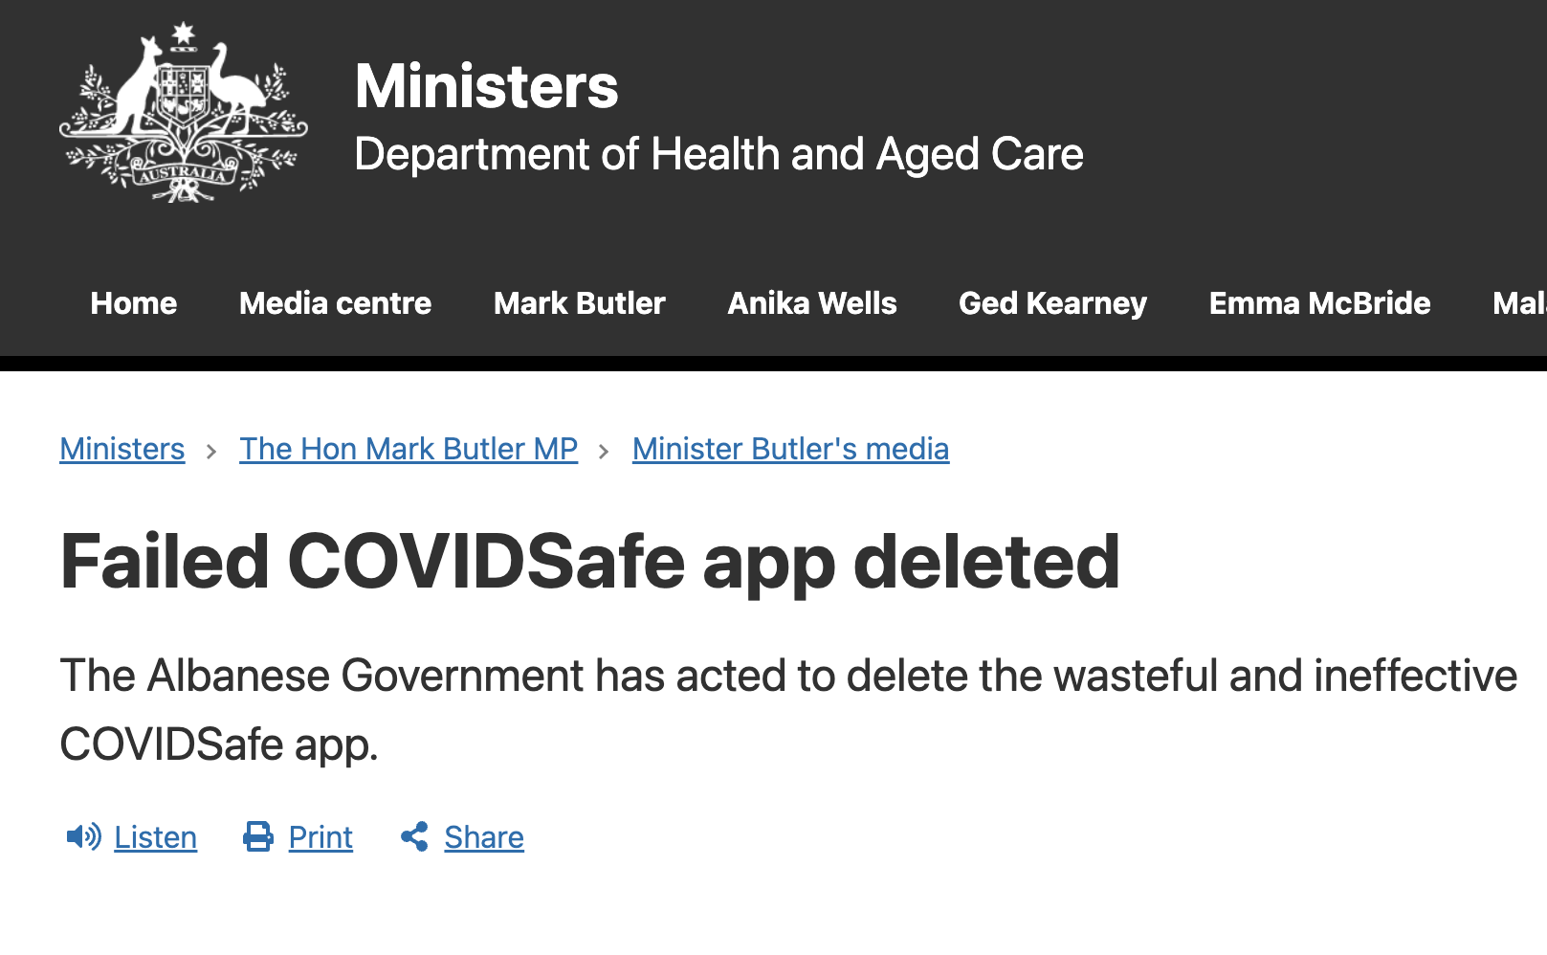
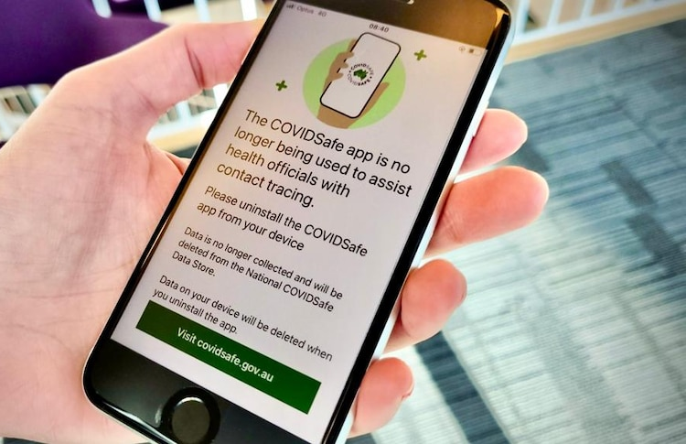
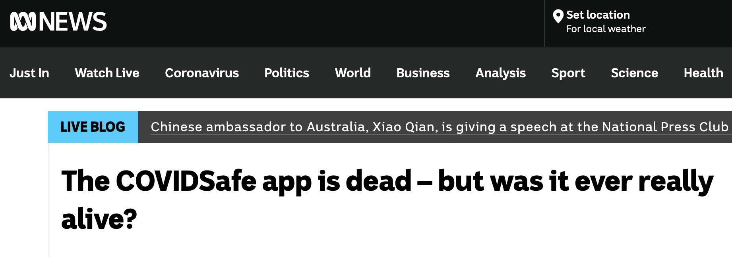
Notes:
COVIDSafe was created to assist with contact tracing during the pandemic.
However, its effectiveness, privacy implications and actual contribution became subjects of public debate.
This example raises questions such as:
Was the collected information necessary?
Was the application sufficiently effective?
Did the public clearly understand its limitations?
Was collecting sensitive information justified by the benefit?
Social-media platforms helped people communicate during the pandemic, but also enabled misinformation, fear and harmful content to spread quickly. Platform algorithms influence what information users see.

Slide 8
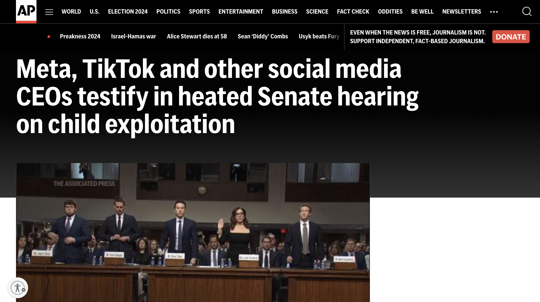
Notes:
This example shows technology leaders being questioned about the effects of social-media platforms on young people.
Recommendation algorithms may continually promote content that maximises attention, even when that content affects users’ mental health or exposes children to inappropriate material.
The key issue is that organisations remain responsible for the social consequences of their algorithms.
Ex: suicidal thought

Slide 9
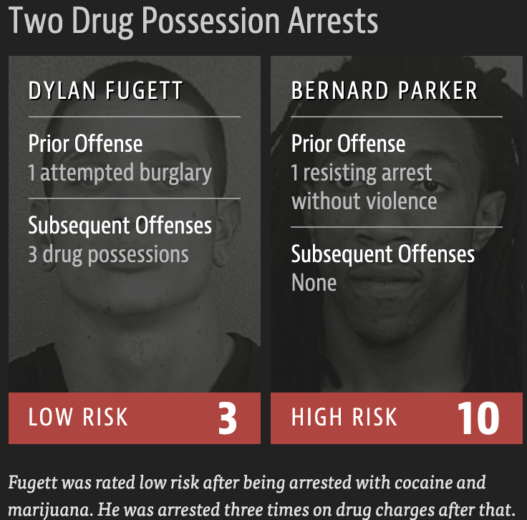
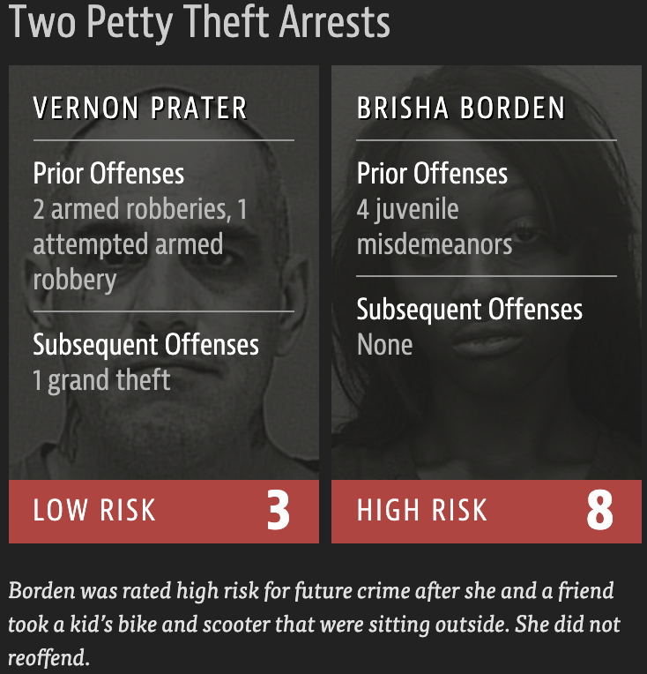
Racial bias in criminal-risk assessment
Falsely labeling black defendants as potential criminals by the recidivism assessment models of the US criminal justice system.
https://www.propublica.org/article/machine-bias-risk-assessments-in-criminal-sentencing
Notes:
Some criminal-risk systems incorrectly labelled Black defendants as higher risk more often than White defendants.
High-impact AI must be evaluated separately across demographic groups, not only through overall accuracy.
Risk-assessment software used in the US criminal-justice system was reported to label Black defendants as high risk more frequently, including cases where they did not reoffend.
An overall accuracy score cannot reveal whether errors are distributed unfairly.
Performance should be compared across demographic groups.
The lesson is:
An AI-supported decision can reinforce historical discrimination when trained on biased data or evaluated inadequately.

Slide 10
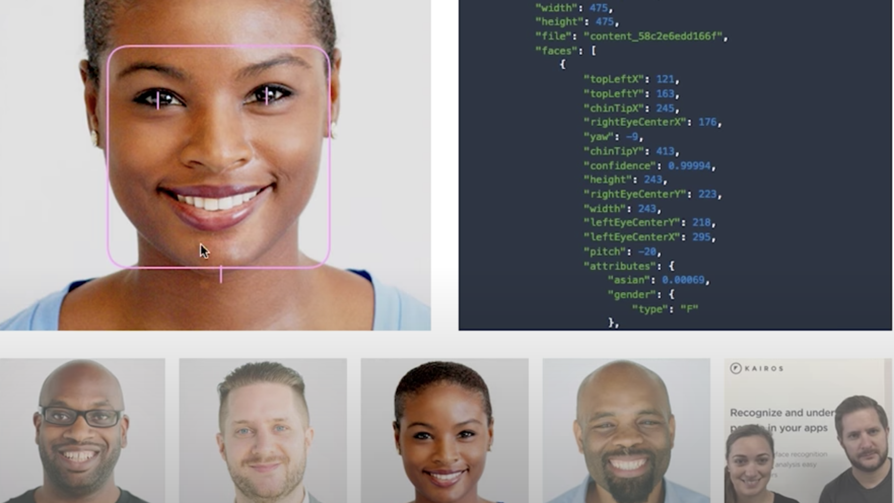
Higher error rate in detecting dark-skinned women compared to light-skinned men in facial recognition software.
Coded Gaze
https://www.youtube.com/watch?v=162VzSzzoPs
https://www.youtube.com/watch?time_continue=299&v=TWWsW1w-BVo&feature=emb_logo
Notes:
Some facial-analysis systems have shown higher error rates for dark-skinned women than for light-skinned men.
Possible reasons include:
Unrepresentative training data
Unequal image quality
Inadequate testing across demographic groups
Design teams lacking diversity
A model should therefore be evaluated separately for different populations rather than only through total accuracy.

Slide 11
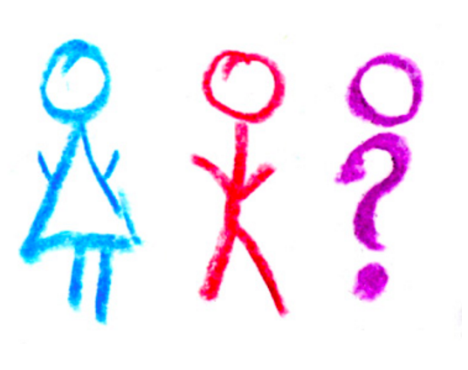
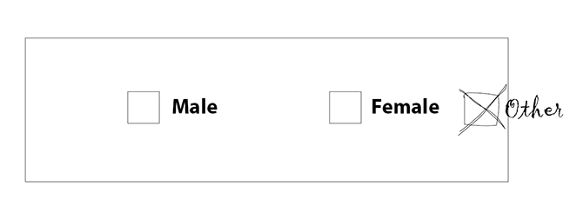
Not all value violations make news headlines!
Sense of belonging
info.umkc.edu
Notes:
Not every value violation becomes a major news story.
Poorly designed systems may quietly reduce dignity, inclusion or a sense of belonging.
For example, a university system that does not recognise a student’s preferred name may not create a dramatic public scandal, but it can still make the student feel excluded.

Slide 12
Human-Centered AI: What is it?
The remarkable progress in AI has opened the doors to new opportunities, and some dark possibilities.
However, a bright future awaits AI researchers, developers, business leaders, policy-makers, and others who build on AI algorithms by including HCAI strategies of design and testing.
This enlarged vision can shape the future of technology so as to better serve human values and needs; the goal is not to replace people but to empower them by making design choices that give humans control over technology.
Notes:
Human-Centred AI, or HCAI, develops AI around human needs, abilities and values.
Its purpose is not simply to replace people. It aims to:
Support human decision-making
Extend human capabilities
Preserve human control
Improve people’s experiences and wellbeing
The central question is:
How can AI empower people rather than make them powerless?
Human-Centred AI designs technology around human needs and values.
Its purpose is not simply to replace people, but to empower them and preserve meaningful human control.

Slide 13











Human-Centered AI Framework:
Reliable, Safe, and Trustworthy Systems
Attributes that make HCAI systems reliable, safe, and trustworthy.
Reliable systems based on sound software
Safety culture through business management strategies
Trustworthy certification by independent oversight
Regulation by government bodies.
Notes:
Four layers contribute to responsible systems:
Reliable software engineering
A reliable system behaves as expected when needed.
Good engineering, testing, monitoring and audit trails help prevent failures and allow investigators to understand what happened.
Organisational safety culture
Safety must be an organisational priority, not merely a software feature.
Leaders should encourage training, open reporting of failures, investigation of near misses and continuous improvement.
Trustworthiness
Trust also depends on institutions. External auditors, professional bodies, insurers, researchers and civil-society organisations can independently examine whether an AI system deserves public trust.
Government regulation
Technical quality alone is insufficient.
Reliable software: sound engineering, testing and monitoring
Safety culture: organisations prioritise safety and learn from failures
Independent certification: external experts examine the system
Government regulation: laws establish requirements and accountability

Slide 14
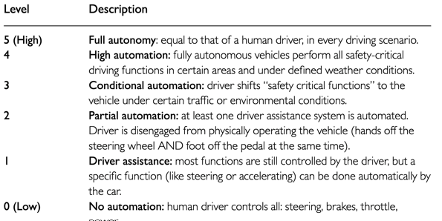
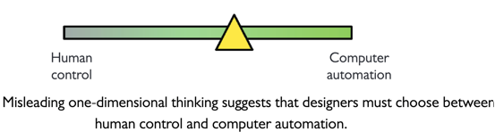
Human-Centered AI Framework:
Rising above the Levels of Automation
Automated systems can be wonderful, but strategies to ensure activation when needed and prevent inadvertent activations contribute to reliable, safe, and trustworthy operation that increases user acceptance.
High levels of human control and high levels of automation increase reliability, safety, and trustworthiness in applications.
Achieving these goals, especially for complex, poorly understood problems, will dramatically increase human performance while supporting human self-efficacy, creativity, responsibility, and social connections.
Notes:
The choice is not simply between human control and automation. A system can provide powerful automation while also maintaining strong human control, producing better performance and greater trust.
Automation and human control are not necessarily opposites.
A system may provide strong automation while retaining strong human control.
For example, an aircraft autopilot performs many tasks automatically, but pilots monitor the system and can intervene.
The desirable goal is often:
High automation+High human control

Slide 15
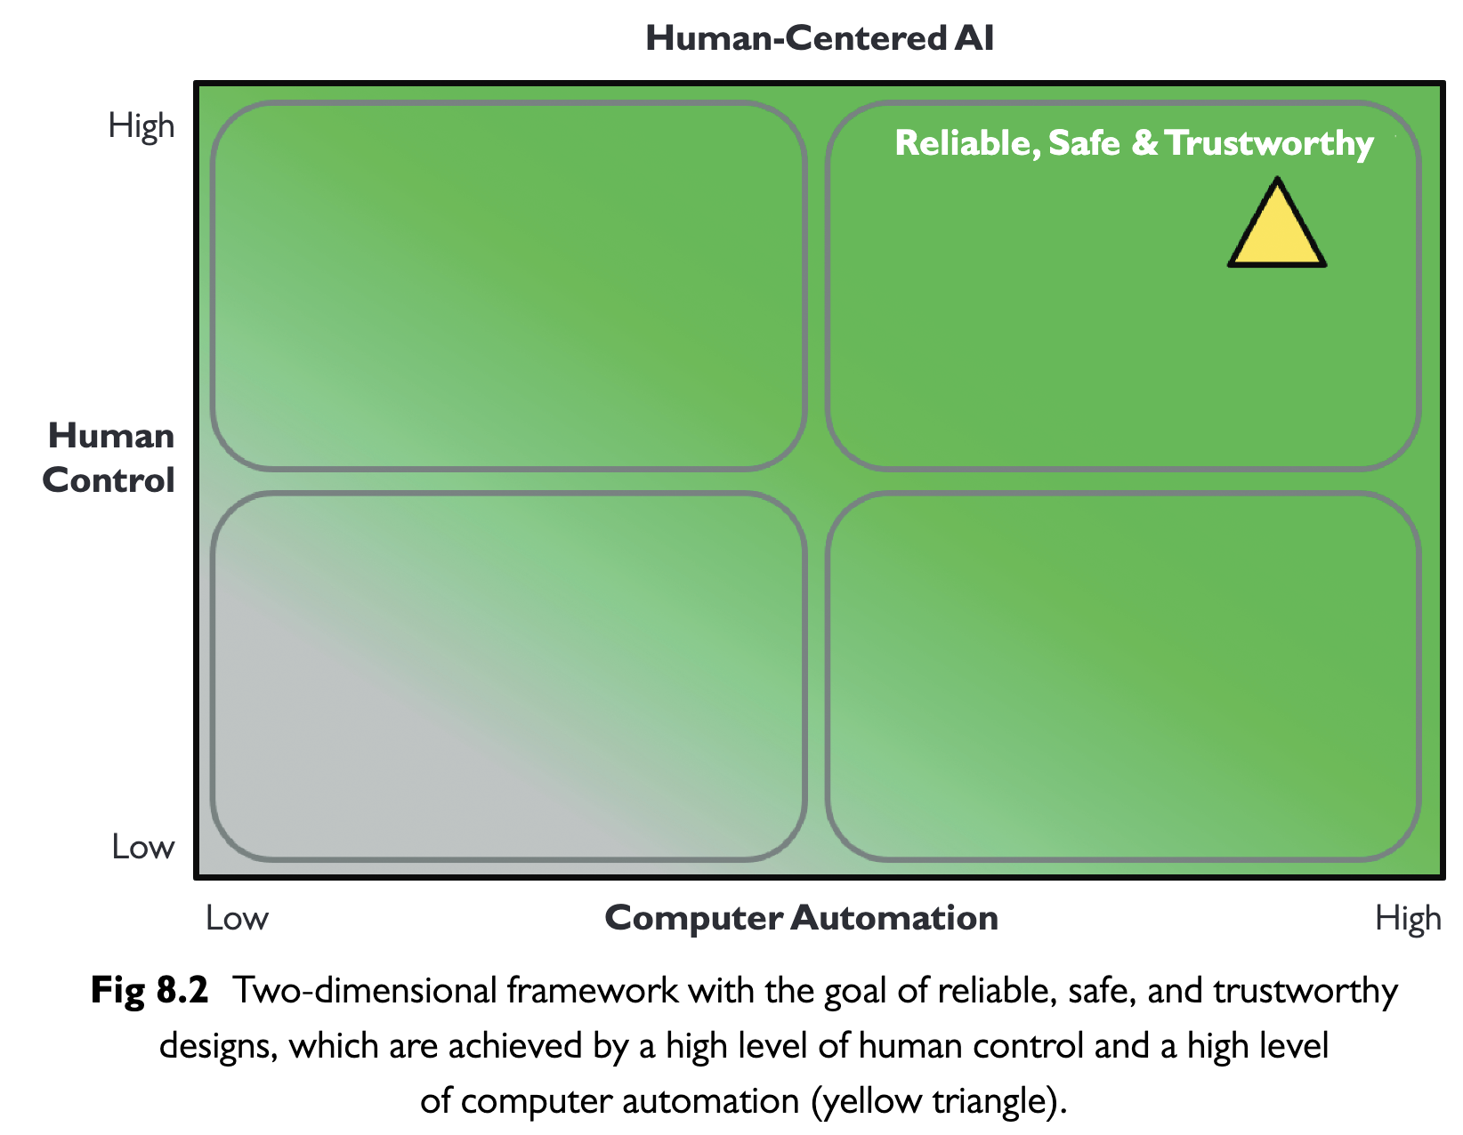
Human-Centered AI Framework:
Two-Dimensional HCAI Framework
The desired goal is often to create designs that are in the upper right quadrant.
The lower right quadrant is home to relatively mature, well-understood systems for predictable tasks, e.g., car automatic transmission.
For poorly understood and complex tasks with varying contexts of use, the upper right quadrant is needed.
Notes:
Human control and automation are presented as separate dimensions. The preferred position for complex tasks is often high automation combined with high human control.
The framework uses two independent dimensions:
Level of computer automation
Level of human control
The upper-right quadrant represents systems with high automation and high human control. This is generally desirable for complex or high-impact activities.
The lower-right area may be suitable for mature, predictable tasks such as an automatic transmission.
Low automation, low control: limited usefulness
High automation, low control: potentially dangerous if the system fails
Low automation, high control: humans perform most tasks
High automation, high control: technology provides capability while humans retain authority

Slide 16
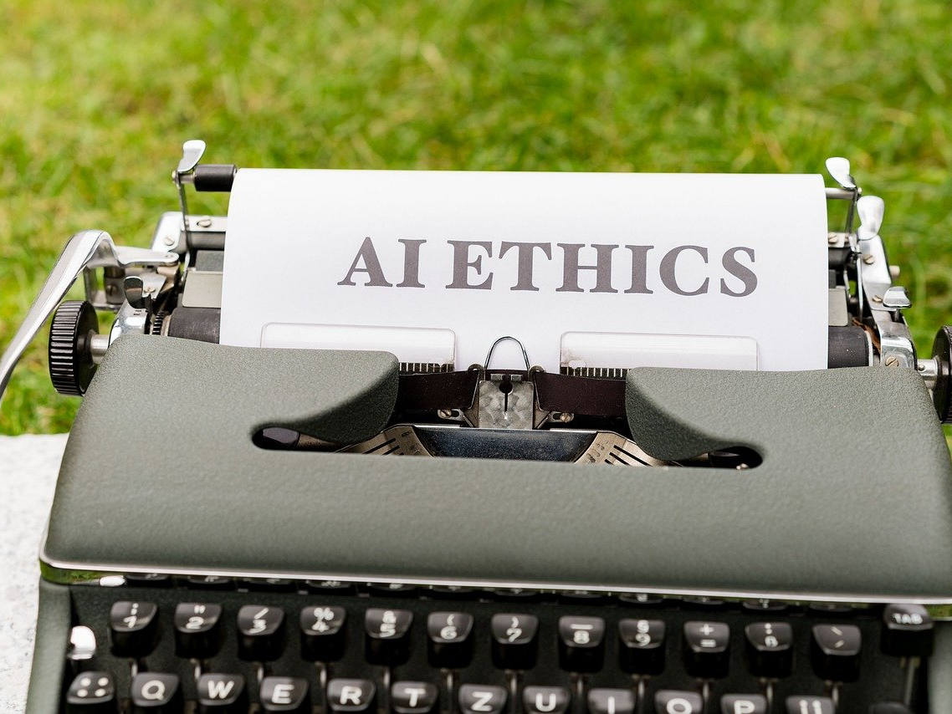
Human-Centered AI:
Strategies for Ethical AI
  Inclusive Design: Engaging diverse groups in AI development to reflect a wide range of human values and perspectives.
  Ethical AI Governance: Developing and enforcing guidelines, policies, and regulations to guide ethical AI development and use.
  Continuous Monitoring: Regularly assessing AI systems for ethical compliance and societal impact.

